Slide 1
HW6-B
Spatial Index
Group Members:
胡宇森 魏辰

Slide 2
Context
Implemented Functions List
Geometry 基本要求： 实现Point到LineString和Polygon之间的欧式距离计算
扩展要求(至少一个)： 实现Polygon的内环几何数据存储，并修改Point到Polygon的欧式距离计算
实现LineString到LineString和Polygon的欧式距离计算
实现MultiPoint、MultiLineString和MultiPolygon类
Envelope 基本要求： 实现contain、intersect和unionEnvelope函数
扩展要求(可选)： 实现Polygon与Envelope相交判断intersects函数
QuadTree 基本要求： 实现constructQuadTree和split函数，创建四叉树
实现rangeQuery函数，完成区域查询
实现NNQuery和pointInLeafNode函数，完成最邻近几何特征查询
拓展要求(至少一个): 基于距离的空间关联 (Spatial Join)
四叉树性能分析
R-Tree 基本要求： 实现constructRTree函数，创建R-Tree
实现rangeQuery函数，完成区域查询
实现NNQuery和pointInLeafNode函数，完成最邻近几何特征查询
拓展要求(至少一个): 基于距离的空间关联 (Spatial Join)
分析四叉树与R-Tree在不同数据下的性能差异
扩展要求(可选) 如已实现多边形的相关函数，测试多边形数据集的区域查询和最邻近查询

Slide 3

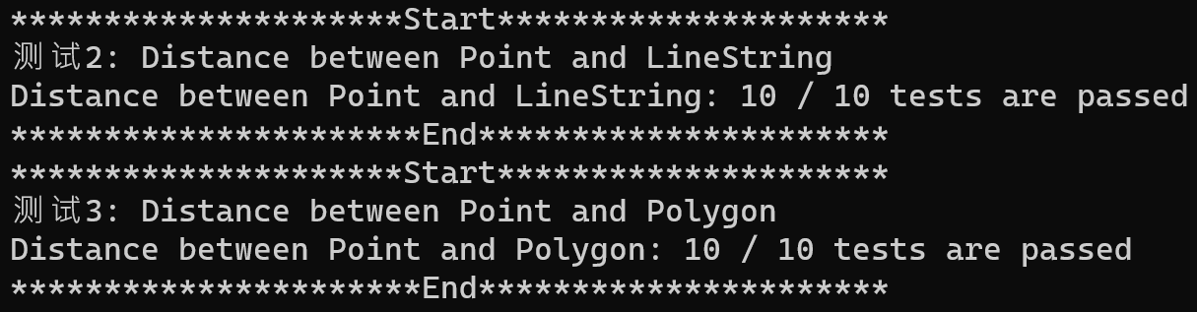
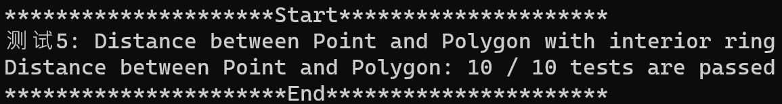
01 Geometry
Distance and InteriorRings
Point to LineString
Point to Polygon
InteriorRings Polygon
使用 std::vector<LineString> 储存 InteriorRings
到多边形的距离遍历时读取内环与外环一同遍历

Slide 4
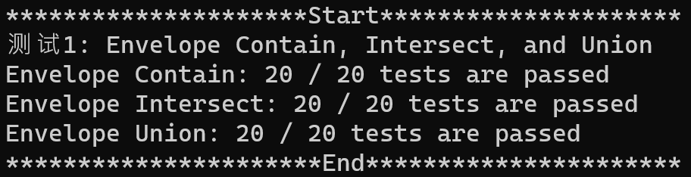
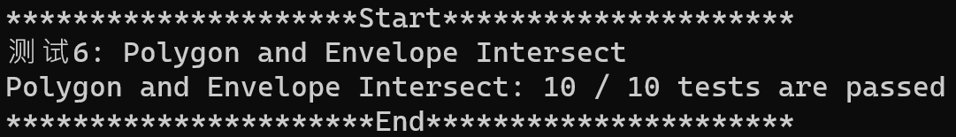
02 Envelope
Envelope
Envelope
Intersect
Polygon
Intersect
Contain
Union
If no,
If no,
ExRing
Intersect?
InRing
Intersect?
Vertex in
Polygon?
If yes
Return true
If no,
Return false

Slide 5
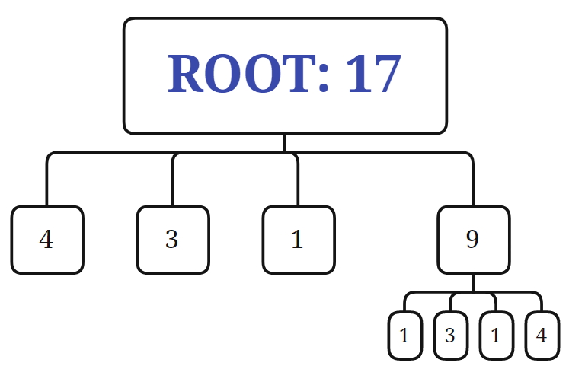
03 QuadTree
Construct
节点分裂，递归生成子节点
非子节点临时储存要素
在子节点内判断为Intersect
存在一个要素被分配到多个子节点中的情况对于线要素或面要素来说尤为常见
Capacity = 4

Slide 6
03 QuadTree
Construct
节点分裂，递归生成子节点
非子节点临时储存要素
在子节点内判断为Intersect
存在一个要素被分配到多个子节点中的情况对于线要素或面要素来说尤为常见
Capacity = 4

Slide 7
03 QuadTree
Construct
节点分裂，递归生成子节点
非子节点临时储存要素
在子节点内判断为Intersect
存在一个要素被分配到多个子节点中的情况对于线要素或面要素来说尤为常见
Capacity = 4

Slide 8
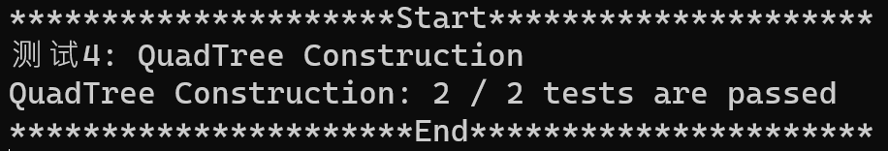
03 QuadTree
Construct
Capacity = 4

Slide 9
03 QuadTree
rangeQuery
Algorithm {
Step 1: Check whether or not bounding box of the node is contained in the query area. If so, all features in the node are added into the candidate set. Otherwise go to step 2.
Step 2: If the node intersects with the query area and the node is a leaf, add the elements whose bounding box intersects the query area into candidate set.
Step 3: If the node intersects with the node but is node a leaf node, then range query is called recursively.
}
Capacity = 4

Slide 10
03 QuadTree
rangeQuery
Algorithm {
Step 1: Check whether or not bounding box of the node is contained in the query area. If so, all features in the node are added into the candidate set. Otherwise go to step 2.
Step 2: If the node intersects with the query area and the node is a leaf, add the elements whose bounding box intersects the query area into candidate set.
Step 3: If the node intersects with the node but is node a leaf node, then range query is called recursively.
}
Capacity = 4

Slide 11
03 QuadTree
rangeQuery
Algorithm {
Step 1: Check whether or not bounding box of the node is contained in the query area. If so, all features in the node are added into the candidate set. Otherwise go to step 2.
Step 2: If the node intersects with the query area and the node is a leaf, add the elements whose bounding box intersects the query area into candidate set.
Step 3: If the node intersects with the node but is node a leaf node, then range query is called recursively.
}
Capacity = 4

Slide 12
03 QuadTree
rangeQuery
Algorithm {
Step 1: Check whether or not bounding box of the node is contained in the query area. If so, all features in the node are added into the candidate set. Otherwise go to step 2.
Step 2: If the node intersects with the query area and the node is a leaf, add the elements whose bounding box intersects the query area into candidate set.
Step 3: If the node intersects with the node but is node a leaf node, then range query is called recursively.
}
Capacity = 4

Slide 13
03 QuadTree
rangeQuery
Algorithm {
Step 1: Check whether or not bounding box of the node is contained in the query area. If so, all features in the node are added into the candidate set. Otherwise go to step 2.
Step 2: If the node intersects with the query area and the node is a leaf, add the elements whose bounding box intersects the query area into candidate set.
Step 3: If the node intersects with the node but is node a leaf node, then range query is called recursively.
}
Capacity = 4

Slide 14
03 QuadTree
rangeQuery
Algorithm {
Step 1: Check whether or not bounding box of the node is contained in the query area. If so, all features in the node are added into the candidate set. Otherwise go to step 2.
Step 2: If the node intersects with the query area and the node is a leaf, add the elements whose bounding box intersects the query area into candidate set.
Step 3: If the node intersects with the node but is node a leaf node, then range query is called recursively.
}
Capacity = 4

Slide 15
03 QuadTree
rangeQuery
Algorithm {
Step 1: Check whether or not bounding box of the node is contained in the query area. If so, all features in the node are added into the candidate set. Otherwise go to step 2.
Step 2: If the node intersects with the query area and the node is a leaf, add the elements whose bounding box intersects the query area into candidate set.
Step 3: If the node intersects with the node but is node a leaf node, then range query is called recursively.
}
Capacity = 4

Slide 16
03 QuadTree
rangeQuery
Algorithm {
Step 1: Check whether or not bounding box of the node is contained in the query area. If so, all features in the node are added into the candidate set. Otherwise go to step 2.
Step 2: If the node intersects with the query area and the node is a leaf, add the elements whose bounding box intersects the query area into candidate set.
Step 3: If the node intersects with the node but is node a leaf node, then range query is called recursively.
}
Capacity = 4

Slide 17
03 QuadTree
NNQuery
Algorithm {
Step 1: Find the cell where the specified point is located. If the cell is empty, find its parent. (pointInLeafNode function, DFS)
Step 2: Find the shortest max distance between the bounding box of the features in the cell and the point.
Step 3: Operate a range query based on the shortest distance calculated above and put the selected features into candidate set.
Step 4: Find out the very feature which is closest to the specified point.
}

Slide 18
03 QuadTree
NNQuery
Algorithm {
Step 1: Find the cell where the specified point is located. If the cell is empty, find its parent. (pointInLeafNode function, DFS)
Step 2: Find the shortest max distance between the bounding box of the features in the cell and the point.
Step 3: Operate a range query based on the shortest distance calculated above and put the selected features into candidate set.
Step 4: Find out the very feature which is closest to the specified point.
}

Slide 19
03 QuadTree
NNQuery
Algorithm {
Step 1: Find the cell where the specified point is located. If the cell is empty, find its parent. (pointInLeafNode function, DFS)
Step 2: Find the shortest max distance between the bounding box of the features in the cell and the point.
Step 3: Operate a range query based on the shortest distance calculated above and put the selected features into candidate set.
Step 4: Find out the very feature which is closest to the specified point.
}

Slide 20
03 QuadTree
NNQuery
Algorithm {
Step 1: Find the cell where the specified point is located. If the cell is empty, find its parent. (pointInLeafNode function, DFS)
Step 2: Find the shortest max distance between the bounding box of the features in the cell and the point.
Step 3: Operate a range query based on the shortest distance calculated above and put the selected features into candidate set.
Step 4: Find out the very feature which is closest to the specified point.
}

Slide 21
03 QuadTree
NNQuery
Algorithm {
Step 1: Find the cell where the specified point is located. If the cell is empty, find its parent. (pointInLeafNode function, DFS)
Step 2: Find the shortest max distance between the bounding box of the features in the cell and the point.
Step 3: Operate a range query based on the shortest distance calculated above and put the selected features into candidate set.
Step 4: Find out the very feature which is closest to the specified point.
}

Slide 22
04 R-Tree
Construct
Algorithm {
Step 1: First create a leaf node, which stores a Feature pointer and the minimum bounding box of itself.
Step 2: Insert the Feature into the node based on the smallest the new area principle.
When feature number flow over M, select the leftmost and the rightmost two features as seed points, group the features by the quadratic split algorithm.
Step 3: Create upper-level internal nodes based on the created leaf nodes, same as step 2.
Step 4: Stop and create root when the number of nodes in a certain layer is less than M.
}
M = 2

Slide 23
04 R-Tree
Construct
Algorithm {
Step 1: First create a leaf node, which stores a Feature pointer and the minimum bounding box of itself.
Step 2: Insert the Feature into the node based on the smallest the new area principle.
When feature number flow over M, select the leftmost and the rightmost two features as seed points, group the features by the quadratic split algorithm.
Step 3: Create upper-level internal nodes based on the created leaf nodes, same as step 2.
Step 4: Stop and create root when the number of nodes in a certain layer is less than M.
}
M = 2

Slide 24
04 R-Tree
Construct
Algorithm {
Step 1: First create a leaf node, which stores a Feature pointer and the minimum bounding box of itself.
Step 2: Insert the Feature into the node based on the smallest the new area principle.
When feature number flow over M, select the leftmost and the rightmost two features as seed points, group the features by the quadratic split algorithm.
Step 3: Create upper-level internal nodes based on the created leaf nodes, same as step 2.
Step 4: Stop and create root when the number of nodes in a certain layer is less than M.
}
M = 2

Slide 25
04 R-Tree
Construct
Algorithm {
Step 1: First create a leaf node, which stores a Feature pointer and the minimum bounding box of itself.
Step 2: Insert the Feature into the node based on the smallest the new area principle.
When feature number flow over M, select the leftmost and the rightmost two features as seed points, group the features by the quadratic split algorithm.
Step 3: Create upper-level internal nodes based on the created leaf nodes, same as step 2.
Step 4: Stop and create root when the number of nodes in a certain layer is less than M.
}
M = 2

Slide 26
04 R-Tree
Construct
Algorithm {
Step 1: First create a leaf node, which stores a Feature pointer and the minimum bounding box of itself.
Step 2: Insert the Feature into the node based on the smallest the new area principle.
When feature number flow over M, select the leftmost and the rightmost two features as seed points, group the features by the quadratic split algorithm.
Step 3: Create upper-level internal nodes based on the created leaf nodes, same as step 2.
Step 4: Stop and create root when the number of nodes in a certain layer is less than M.
}
M = 2

Slide 27
04 R-Tree
Construct
Algorithm {
Step 1: First create a leaf node, which stores a Feature pointer and the minimum bounding box of itself.
Step 2: Insert the Feature into the node based on the smallest the new area principle.
When feature number flow over M, select the leftmost and the rightmost two features as seed points, group the features by the quadratic split algorithm.
Step 3: Create upper-level internal nodes based on the created leaf nodes, same as step 2.
Step 4: Stop and create root when the number of nodes in a certain layer is less than M.
}
M = 2

Slide 28
04 R-Tree
Construct
Algorithm {
Step 1: First create a leaf node, which stores a Feature pointer and the minimum bounding box of itself.
Step 2: Insert the Feature into the node based on the smallest the new area principle.
When feature number flow over M, select the leftmost and the rightmost two features as seed points, group the features by the quadratic split algorithm.
Step 3: Create upper-level internal nodes based on the created leaf nodes, same as step 2.
Step 4: Stop and create root when the number of nodes in a certain layer is less than M.
}
M = 2

Slide 29
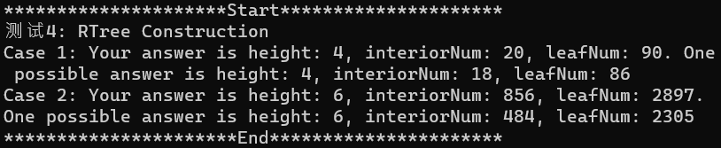
04 R-Tree
Construct
Algorithm {
Step 1: First create a leaf node, which stores a Feature pointer and the minimum bounding box of itself.
Step 2: Insert the Feature into the node based on the smallest the new area principle.
When feature number flow over M, select the leftmost and the rightmost two features as seed points, group the features by the quadratic split algorithm.
Step 3: Create upper-level internal nodes based on the created leaf nodes, same as step 2.
Step 4: Stop and create root when the number of nodes in a certain layer is less than M.
}

Slide 30
04 R-Tree
rangeQuery and NNQuery
Algorithm {
Step 1: Check whether or not bounding box of the node is contained in the query area. If so, all features in the node are added into the candidate set. Otherwise go to step 2.
Step 2: If the node intersects with the query area and the node is a leaf, add the elements whose bounding box intersects the query area into candidate set.
Step 3: If the node intersects with the node but is node a leaf node, then range query is called recursively.
}
Algorithm {
Step 1: Find the cell where the specified point is located. If the cell is empty, find its parent. (pointInLeafNode function, DFS)
Step 2: Find the shortest max distance between the bounding box of the features in the cell and the point.
Step 3: Operate a range query based on the shortest distance calculated above and put the selected features into candidate set.
Step 4: Find out the very feature which is closest to the specified point.
}

Slide 31
05 Performance Test
Data
 | 测试8: QuadTreeAnalysis |  |  |  |  |  |  | 测试8: R-TreeAnalysis
 | Capicity | Height | Interior node number | Leaf node number | Construction time | NNQuery time | relative NNQuery time | Capicity | Height | Interior node number | Leaf node number | Construction time | NNQuery time | relative NNQuery time
taxi number: 466951 | 70 | 13 | 5925 | 17776 | 1.166 | 124.605 | 0.000266848 | 70 | 4 | 372 | 11759 | 12.9 | 112.29 | 0.000240475
 | 80 | 13 | 5230 | 15691 | 1.15 | 98.617 | 0.000211193 | 80 | 4 | 281 | 10381 | 15.275 | 148.034 | 0.000317023
 | 90 | 13 | 4677 | 14032 | 1.143 | 82.856 | 0.00017744 | 90 | 4 | 217 | 9248 | 13.819 | 85.469 | 0.000183036
 | 100 | 13 | 4227 | 12682 | 0.977 | 76.995 | 0.000164889 | 100 | 4 | 187 | 8393 | 8.992 | 82.238 | 0.000176117
 | 110 | 12 | 3840 | 11521 | 1.24 | 62.094 | 0.000132978 | 110 | 4 | 160 | 7593 | 7.762 | 72.958 | 0.000156243
 | 120 | 12 | 3521 | 10564 | 0.994 | 60.812 | 0.000130232 | 120 | 4 | 133 | 7098 | 7.204 | 125.985 | 0.000269803
 | 130 | 12 | 3251 | 9754 | 0.931 | 58.13 | 0.000124488 | 130 | 3 | 118 | 6538 | 6.637 | 88.352 | 0.00018921
 | 140 | 12 | 3023 | 9070 | 0.981 | 56.289 | 0.000120546 | 140 | 3 | 90 | 6101 | 6.246 | 138.373 | 0.000296333
 | 150 | 12 | 2833 | 8500 | 1.157 | 54.682 | 0.000117104 | 150 | 3 | 89 | 5672 | 6.062 | 117.926 | 0.000252545
 | 160 | 12 | 2646 | 7939 | 1.234 | 45.067 | 9.65133E-05 | 160 | 3 | 75 | 5489 | 5.834 | 98.322 | 0.000210562
 | 170 | 12 | 2490 | 7471 | 0.931 | 49.068 | 0.000105082 | 170 | 3 | 62 | 5114 | 4.747 | 148.602 | 0.000318239
 | 180 | 12 | 2342 | 7027 | 1.036 | 41.07 | 8.79536E-05 | 180 | 3 | 60 | 4858 | 4.529 | 179.512 | 0.000384434
 | 190 | 12 | 2227 | 6682 | 0.919 | 45.454 | 9.73421E-05 | 190 | 3 | 65 | 4547 | 4.385 | 247.817 | 0.000530713
 | 200 | 12 | 2121 | 6364 | 0.945 | 38.228 | 8.18673E-05 | 200 | 3 | 56 | 4404 | 4.771 | 135.17 | 0.000289474
highway number: 12433 | 70 | 8 | 219 | 658 | 0.008 | 10.652 | 0.000856752 | 70 | 3 | 18 | 499 | 0.014 | 42.041 | 0.003381404
 | 80 | 8 | 187 | 562 | 0.004 | 9.271 | 0.000745677 | 80 | 3 | 10 | 427 | 0.011 | 21.877 | 0.001759591
 | 90 | 8 | 160 | 481 | 0.006 | 9.139 | 0.00073506 | 90 | 3 | 6 | 342 | 0.01 | 30.729 | 0.002471568
 | 100 | 7 | 140 | 421 | 0.003 | 9.082 | 0.000730475 | 100 | 3 | 9 | 369 | 0.01 | 25.697 | 0.002066838
 | 110 | 7 | 124 | 373 | 0.004 | 9.029 | 0.000726212 | 110 | 3 | 6 | 314 | 0.009 | 32.963 | 0.002651251
 | 120 | 7 | 111 | 334 | 0.003 | 9.03 | 0.000726293 | 120 | 3 | 4 | 237 | 0.007 | 15.676 | 0.001260838
 | 130 | 7 | 100 | 301 | 0.004 | 8.927 | 0.000718009 | 130 | 3 | 4 | 199 | 0.006 | 9.058 | 0.000728545
 | 140 | 7 | 93 | 280 | 0.003 | 8.374 | 0.00067353 | 140 | 3 | 4 | 240 | 0.007 | 14.572 | 0.001172042
 | 150 | 7 | 87 | 262 | 0.003 | 7.59 | 0.000610472 | 150 | 3 | 3 | 198 | 0.007 | 12.431 | 0.000999839
 | 160 | 7 | 78 | 235 | 0.003 | 7.444 | 0.000598729 | 160 | 3 | 3 | 215 | 0.007 | 11.241 | 0.000904126
 | 170 | 7 | 74 | 223 | 0.004 | 7.468 | 0.00060066 | 170 | 3 | 3 | 184 | 0.006 | 9.644 | 0.000775678
 | 180 | 7 | 69 | 208 | 0.003 | 7.112 | 0.000572026 | 180 | 3 | 2 | 168 | 0.006 | 14.083 | 0.001132711
 | 190 | 7 | 64 | 193 | 0.003 | 7.153 | 0.000575324 | 190 | 3 | 2 | 158 | 0.006 | 10.468 | 0.000841953
 | 200 | 7 | 59 | 178 | 0.003 | 7.214 | 0.00058023 | 200 | 3 | 2 | 154 | 0.005 | 30.364 | 0.00244221
station number: 488 | 70 | 3 | 4 | 13 | 0 | 0.277 | 0.000567623 | 70 | 3 | 2 | 12 | 0.001 | 0.436 | 0.000893443
 | 80 | 3 | 4 | 13 | 0 | 0.273 | 0.000559426 | 80 | 3 | 2 | 11 | 0 | 0.477 | 0.000977459
 | 90 | 3 | 4 | 13 | 0 | 0.273 | 0.000559426 | 90 | 3 | 2 | 9 | 0 | 0.456 | 0.000934426
 | 100 | 3 | 3 | 10 | 0.001 | 0.304 | 0.000622951 | 100 | 3 | 2 | 8 | 0 | 0.471 | 0.000965164
 | 110 | 3 | 3 | 10 | 0 | 0.31 | 0.000635246 | 110 | 3 | 2 | 8 | 0 | 0.477 | 0.000977459
 | 120 | 3 | 3 | 10 | 0.001 | 0.303 | 0.000620902 | 120 | 3 | 2 | 7 | 0 | 0.54 | 0.001106557
 | 130 | 3 | 3 | 10 | 0 | 0.305 | 0.000625 | 130 | 3 | 2 | 6 | 0 | 0.615 | 0.001260246
 | 140 | 3 | 3 | 10 | 0 | 0.304 | 0.000622951 | 140 | 3 | 2 | 5 | 0 | 0.582 | 0.001192623
 | 150 | 3 | 2 | 7 | 0 | 0.392 | 0.000803279 | 150 | 3 | 2 | 4 | 0 | 0.647 | 0.00132582
 | 160 | 3 | 2 | 7 | 0.001 | 0.391 | 0.00080123 | 160 | 3 | 2 | 5 | 0.001 | 0.725 | 0.001485656
 | 170 | 3 | 2 | 7 | 0 | 0.391 | 0.00080123 | 170 | 3 | 2 | 4 | 0 | 0.731 | 0.001497951
 | 180 | 3 | 2 | 7 | 0 | 0.396 | 0.000811475 | 180 | 3 | 2 | 4 | 0 | 0.698 | 0.001430328
 | 190 | 2 | 1 | 4 | 0 | 0.499 | 0.001022541 | 190 | 3 | 2 | 4 | 0 | 0.766 | 0.001569672
 | 200 | 2 | 1 | 4 | 0 | 0.494 | 0.001012295 | 200 | 3 | 2 | 3 | 0 | 0.798 | 0.001635246

Slide 32
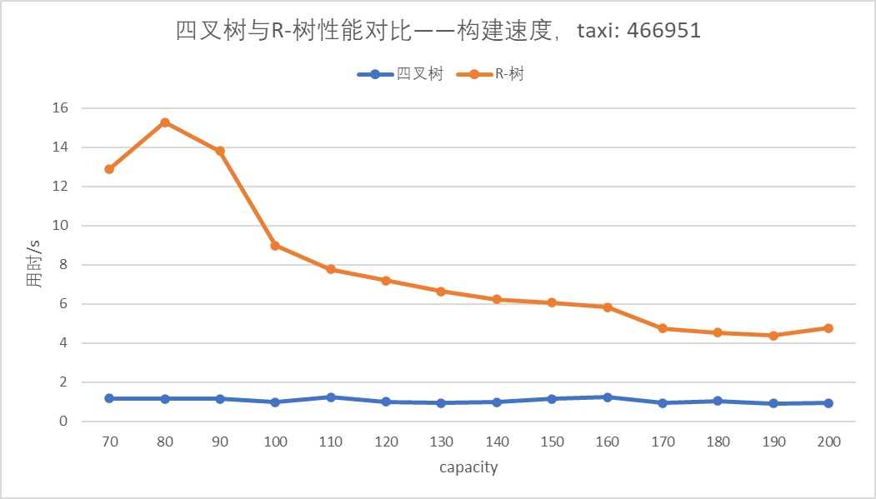
05 Performance Test
Construct

Slide 33
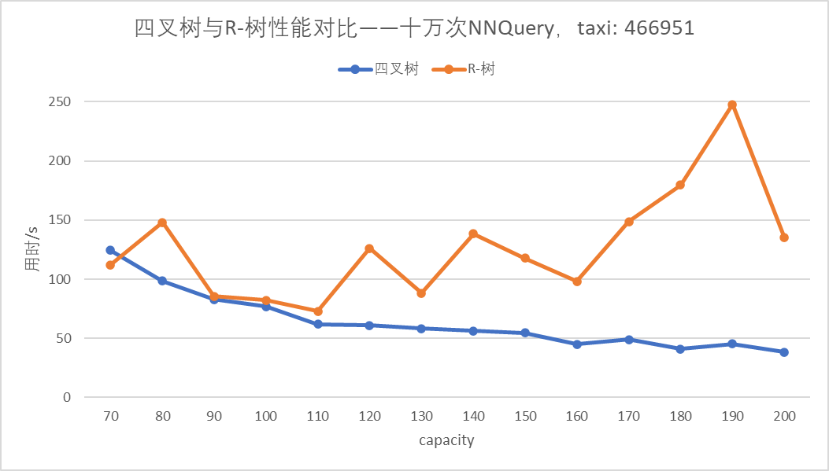
05 Performance Test
NNQuery

Slide 34
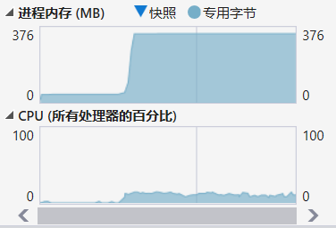
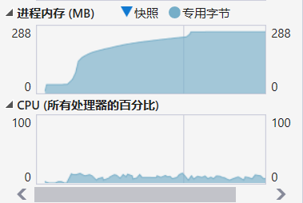
05 Performance Test
NNQuery
QuadTree
R-Tree

Slide 35
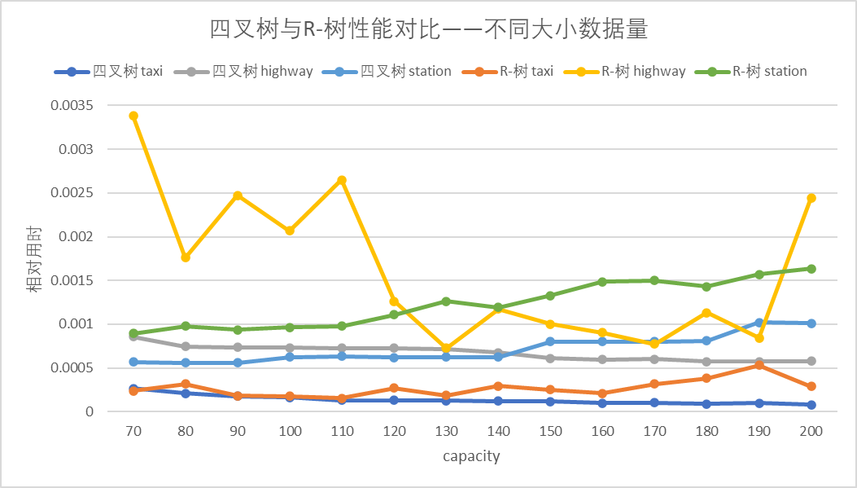
05 Performance Test
Different Data
taxi: 466951
highway: 12433
station: 488

Slide 36
Spatial Index
Thanks for Your Listening
Group Members:
胡宇森 魏辰

